Slide 1
Shiny Workshop Day 1
August 27, 2019
TEA Analytics

Slide 2
Lunch / Installations

Slide 3
To-Do List for Lunch time
Check the installation of needed apps
R
Rstudio
Git
Download zipped files and save it at Desktop
https://github.com/TEA-Analytics/ShinyWorkshop/releases
Install packages
01_InstallPackages.r
Make sure to change the name (github username) and email before running the line 30.
Get a cheat sheet and look through it.

Slide 4
Shiny Basics Review

Slide 5


UI and Server
Server
UI
Give me this.
Here it is.
I know how to compute.
I know how to display.
“UI” specifies layout of the app and requests things to a server when needed.
“Server” gives requested whatever (plot, table, …).
Both UI and server are within R.

Slide 6
Server and Shiny-Server
“Server” may refer to the server section of the app.
“Shiny Server” may mean an actual web server that hosts shiny apps.
Topics of deployment will be covered tomorrow.
You have to know the context for knowing which.
We’ll talk more about (1) today.
We’ll talk more about (2) tomorrow.

Slide 7
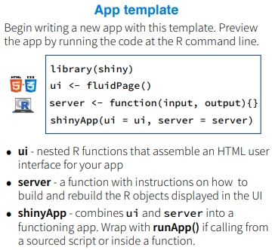
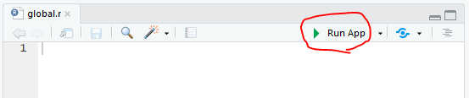
File structures
Many examples online will have everything in one script called app.r.
Use ShinyApp(ui, server) to run the code.
For a small app, it’s easy to see everything.
Our default file structure is to break it down to 3 (or more) files:
Ui.r
Server.r
Global.r (Optional)
All these 3 files needs to be in a same folder.
Use runApp(‘foldername’) or ‘Run App’ button in RStudio.

Slide 8
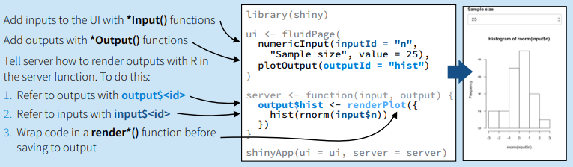
Basic Code Structures
Server
UI
I can access values for “n” as input$n
User gave me a value for “n”
Here is output$hist
plotOutput requests “hist”

Slide 9
Basic Code Structures
Both input and output ids need to be unique.
User inputs are available as input$inputid in the server.
The ui requests * when it encounters *Output(). The server returns output$* of a corresponding data type, render*().
Reference
Cheat Sheet
Shiny Widget Gallery (https://shiny.rstudio.com/gallery/widget-gallery.html)

Slide 10
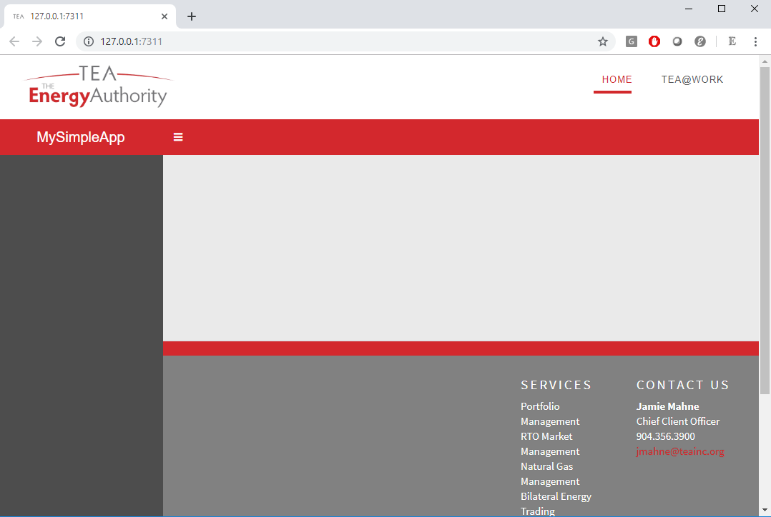
‘teadashboard’ TEA-version of ‘shinydashboard’
In general, we recommend using the ‘teadashboard.’
All functionalities are the same with shinydashboard.
Open “TheSimplest” template and run it.
The RunApp button.

Slide 11
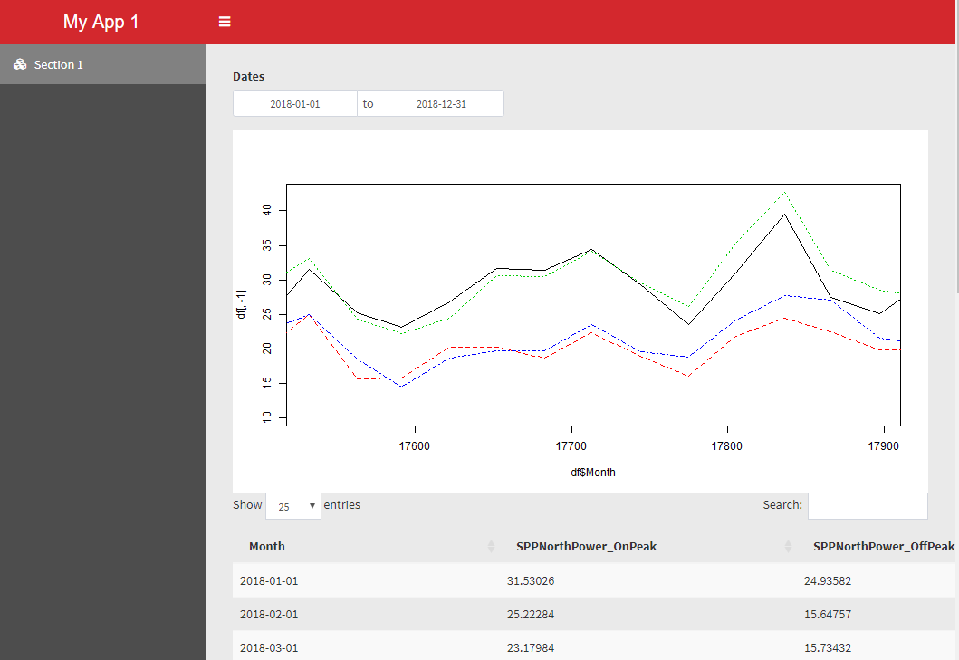
Exercise 1-01
Add Date range selector.
Add time series plot for HistSpotMonthlyAve_SPP.csv.
Add section 1.
Add a corresponding table.

Slide 12
Exercise: 1-01
Run the simplest template.
Break it down to 3 files.
Create a app folder.
Ui.r, server.r, and global.r.
Add the following:
Read in SPP data in ‘Data’ folder.
Add a section (menuitem)
Add a date range selector
Add time series plot
Add a table.
Use
Read.csv
menuItem
dateRangeInput
plotOutput/renderPlot
dataTableOutput/renderDataTable

Slide 13
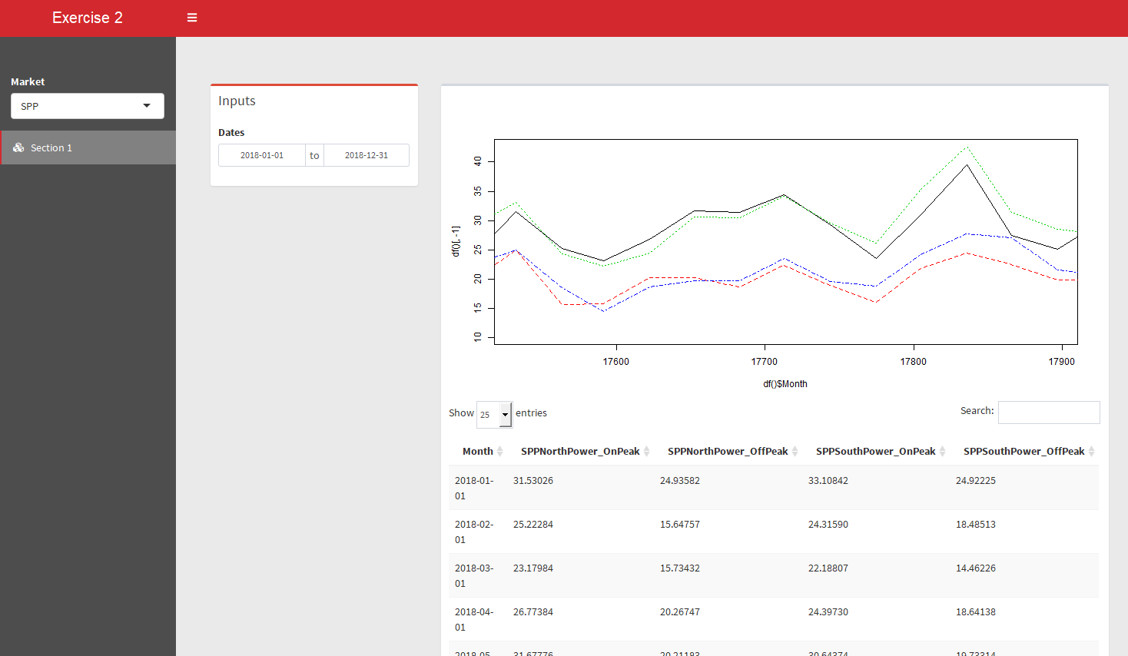
Exercise 1-02
Add a selector for Market.
Display the corresponding data.
All objects in boxes.

Slide 14
Exercise 1-02
Add box() for objects in the body.
Make the data dependent on “market” by
Creating an input selector for market in the sidebar and make “SPP” and “CAISO” available.
Creating a reactive object for data.
Reference the reactive objects in the plot and the table.
Use:
box
selectInput
reactive

Slide 15
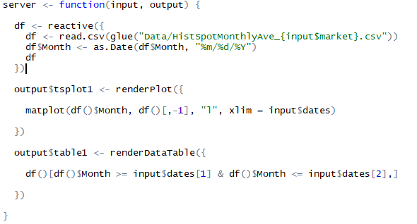
Reactive?
Reactive objects live in reactive environments.
Reactive objects
Input$xxx
Reactive()
reactiveValue
Reactive Environments
Inside render*
Inside reactive*
Inside observe*.

Slide 16
Layout

Slide 17
Layout (1-03)
Always use boxes.
Use fluidRow and columns for dividing the page.
Within the divided section of the page, width is specified over 12.
Height specification optional.
Box (3)
Box (width = 9)
Fluid row
Box (6)
Box(4)
Box (width = 12)
Fluid row
Box(12)
Column (width = 8)
Column (column = 4)

Slide 18
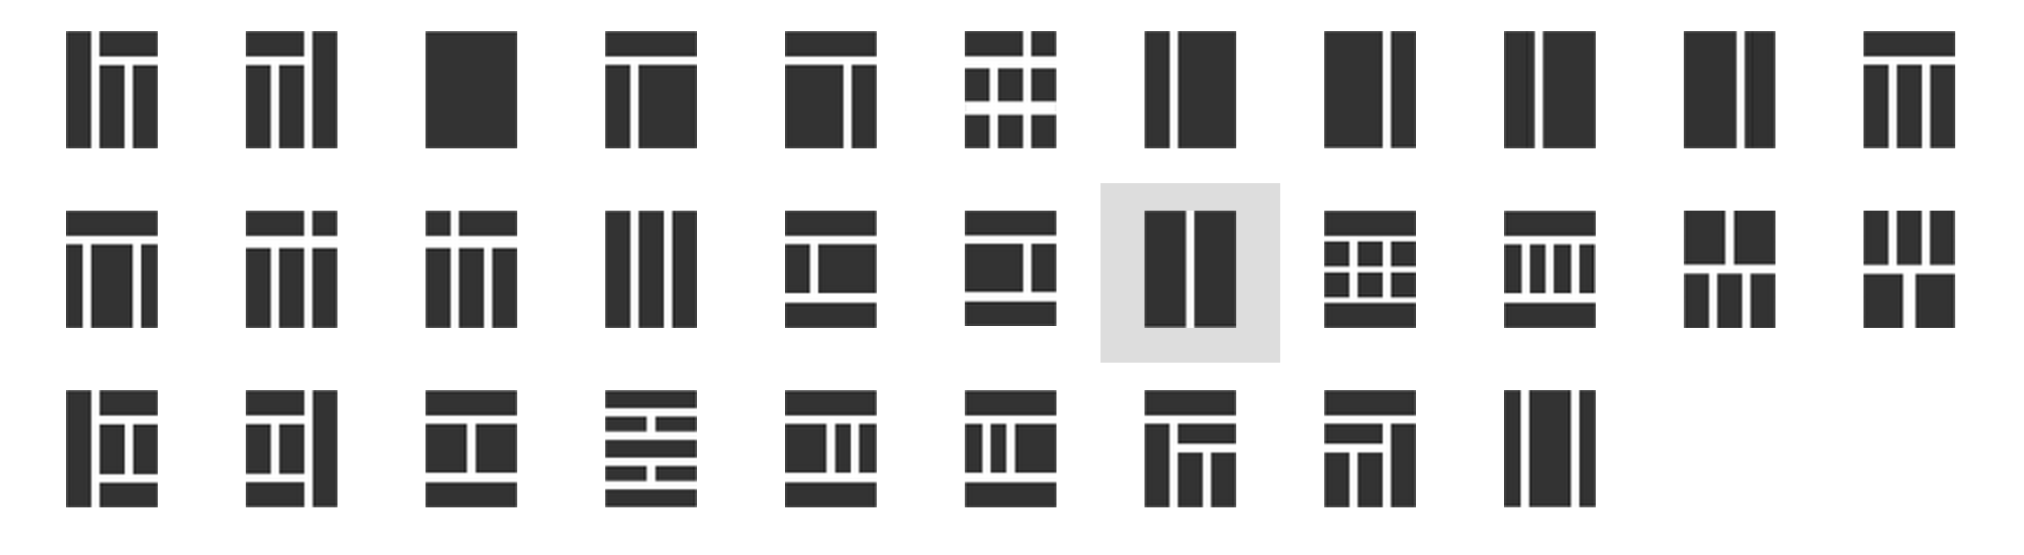
Examples
1
3
2

Slide 19

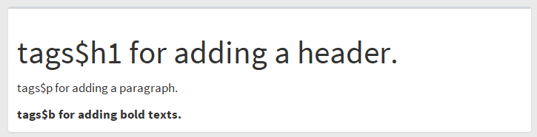
Exercise 1-03
Add anther section (menuitem) and add boxes like this:
Add some texts using tags$xxx.
Open the ‘TEABranded’ template, run it and notice
A few different layouts
Sidebar submenues
tabBox
User login.
“About” page
Check out icons
https://rstudio.github.io/shinydashboard/appearance.html#icons

Slide 20
Tour of Existing TEA Shiny Apps

Slide 21
LMP Forecast
https://analyze.teainc.org/LMP-Forecast-Main/
Notice
Progress Bar
Select Inputs with multiple choices
Interactivity with htmlwidgets (prepackaged interactive plots).
Ability to update data and rerun the model.

Slide 22
DeltaHedging
https://analyze.teainc.org/DeltaHedging/
Notice
Excel like look and feel.
Base shiny interactivity
Database connections (read/write)

Slide 23
HedgeFox
https://analyze.teainc.org/HedgeFox/CAISO/
Notice:
Disabled inputs.
Hidden tabs
Use of information boxes.
Rmarkdown reports.
Synched up date-pickers.
Meaningful error messages.
Subfolder structures

Slide 24
Short Term Net Position Tool
https://analyze.teainc.org/WC-STNP/
Notice:
HTML reports with interactivity.

Slide 25
Understanding Reactivity

Slide 26
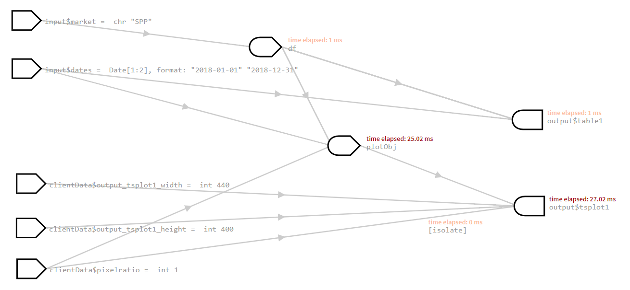
Our First App
Reactive value
Reactive expression
observer

Slide 27
When a Page is Opened
Reactive value
Reactive expression
observer
Follow the arrow backward for UI requests.

Slide 28
When a Page is Opened
Reactive value
Reactive expression
observer
Follow the arrow forward for updates of requested.

Slide 29
When Input Changes 1
Reactive value
Reactive expression
observer
Invalidated
Follow the arrow forward for “Invalidating”

Slide 30
When Input Changes 1
Reactive value
Reactive expression
observer
Invalidated
Update values if they are requested by UI. (Lazy reactivity).

Slide 31
When Input Changes 2
Reactive value
Reactive expression
observer
Invalidated
Invalidated

Slide 32
Demo 1-04
options(shiny.reactlog=TRUE)
If TRUE, enable logging of reactive events, which can be viewed later with the showReactLog function. This incurs a substantial performance penalty and should not be used in production.

Slide 33
Objects
R objects
Data frames
Arrays
Functions
List
…
Input$*
Reactive
ReactiveValues
← Think this like a function
← Think this like a list.

Slide 34


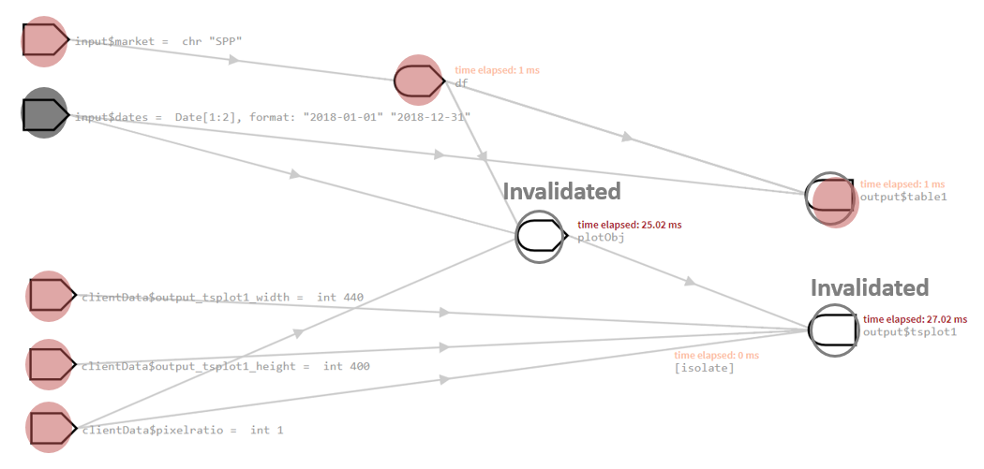
Reactive as a Function with Memory
Functions
Computes every time it’s called.
Reactive
It caches values.
It knows when inputs change.
It returns cached values if inputs haven’t changed.
V.S.

Slide 35
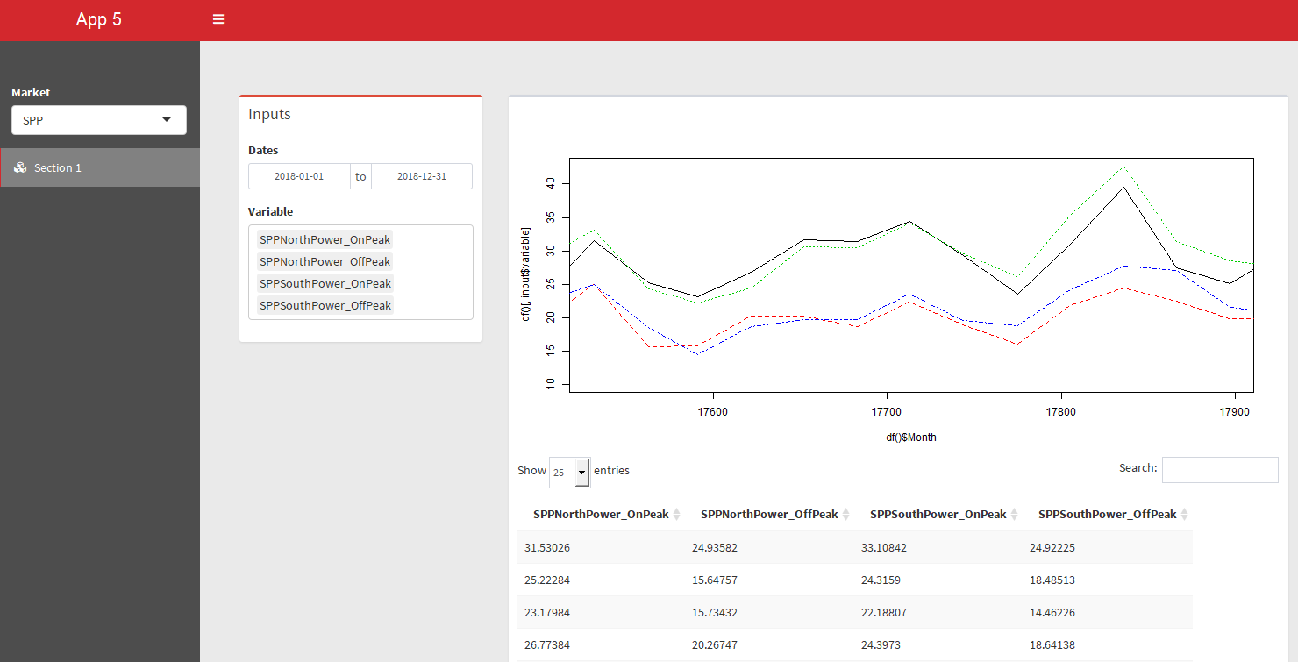
Exercise 1-05
Add an input selector where you can choose which column to plot.

Slide 36
Exercise 1-05
Add a input selector where you can choose which price columns to show.
Use:
selectInput(multiple = TRUE)
uiOutput/renderUI

Slide 37

Exercise 1-05
Look at reactivity log.
Observe:
Everything showed up quickly, but there were bunch of updating underneath.
Reactivity can become complicated fast, if you use particular objects in the app.
Dynamic UIs
rhandsontable
We don’t have to worry about reactivity, until we have to.
A flash of error messages.

Slide 38
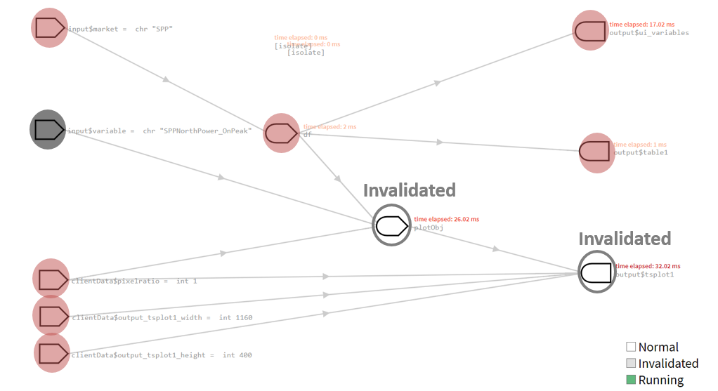
Control Dependencies
Req() & validate(need())
Ensure that values are available before proceeding with a calculation or action.
Add reactive objects.
Create dependency
Isolate()
Avoid dependency.
EventReactive()
Specify the dependency.

Slide 39
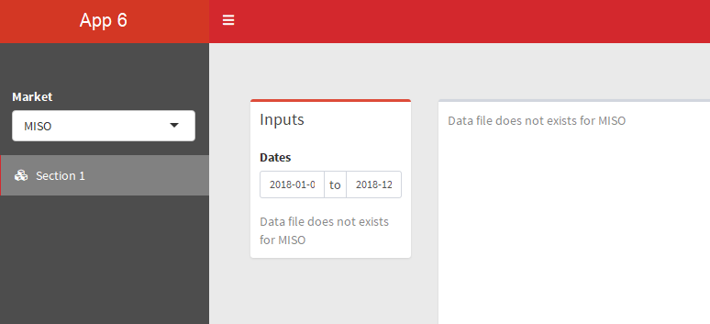
Exercise 1-06
Add “MISO”
Add show a message if a corresponding data file does not exist.

Slide 40
Exercise 1-06
Add req() for dymanic UI variable, making output$tsplot1 required for valid input$variable values.
Add another market “MISO” to input$market and use validate() for checking if the data source exists.
Use:
Req
Validate(need())

Slide 41
Observers
Behaviors
Triggered every time one of its inputs changes (regardless of whether values are needed).
Yields no output.
Useful in
Reset input$xxx values using ‘update*Input’ functions.
Display pop-up messages.
Modifying reactiveValues
…
Observe: watches for all dependent reactive objects.
observeEvent: reacts to only specified reactive objects.

Slide 42
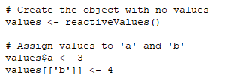
ReactiveValues
ReactiveValue is
Updated and/or called inside
reactive expression or observer.
You need to control when it updates.
No automatic updates when dependencies change.
It can be updated even when outputs are not needed.
Recall ‘reactive’
You don’t have to worry about dependencies.
Unless manually controlled, it’ll know the dependencies.
It updates only when needed.
eager
lazy

Slide 43
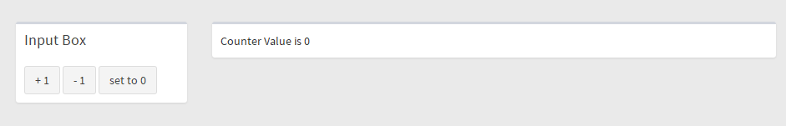
Demo 1-07
Use of Observe and reactiveValues

Slide 44
Use Cases for ReactiveValues
Need to store status and status changes based on multiple inputs
Partial data imports and append.
Append data as needed.
Examples:
https://github.com/TEA-Analytics/DeltaHedging/blob/master/RCode/shiny-app/server.r#L61
https://github.com/TEA-Analytics/LMP-Forecast/blob/master/LMP-Forecast-Main/server.R#L7

Slide 45
Summary on Reactivity
First, think reactive.
Then think req, validate, isolate or eventReactive.
Then think reactiveValues with observe.
More control over dependencies.

Slide 46
Table Choices

Slide 47
Table Choices
Datatable (DT) – base shiny
https://rstudio.github.io/DT/
Formattable
https://renkun-ken.github.io/formattable/
Beautiful display
Rhandsontable
https://jrowen.github.io/rhandsontable/
Easy user input table.
Excel like look and feel.

Slide 48
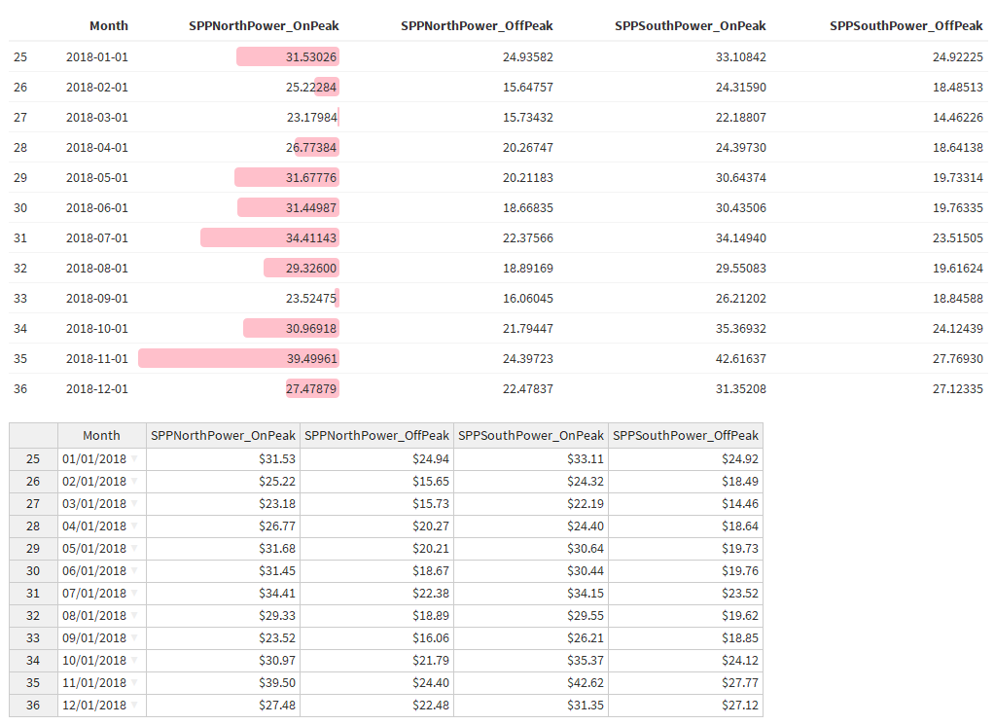
Exercise 1-08
Change the table to formattable with normalize_bar
Change the table to rhandsontable
With units

Slide 49
Exercise 1-08
Try using rhandsontable.
Try using formattable.
For now, hard cord the column name to use normalize bar.
Use:
library(rhandsontable)
rHandsontableOutput / renderRHandsontable
Rhandsontable(df) %>% hot_cols(format = “$0,0.00”)
library(formattable)
formattableOutput / renderFormattable
Formattable(df, list(col1 = normalize_bar(“pink”)))

Slide 50
Interactive Plots

Slide 51
Approaches
Use htmlwidgets
https://www.htmlwidgets.org/
Leaflet
Dygraph
Plotly
Use base Shiny
https://analyze.teainc.org/DeltaHedging/
https://shiny.rstudio.com/gallery/plot-interaction-basic.html

Slide 52
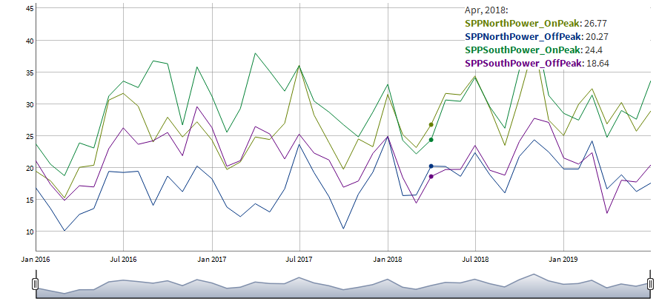
Exercise 1-09
Change the time series plot to dygraph.

Slide 53
Exercise 1-09
Use Dygraph for tsplot.
Dygraph takes xts objects. Load both dygraph and xts libraries.
Convert data frame into xts before feeling into the dygraph function.
Use:
library(dygraphs)
library(xts)
Xts(, order.by)
dygraph() %>% dyRangeSelector()

Slide 54
Miscellaneous Tips

Slide 55
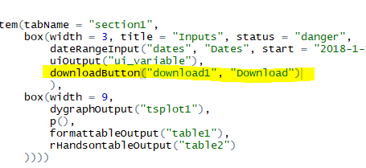
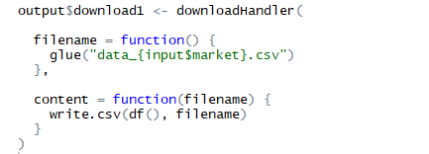
Download Demo 1-10
downloadButton
↔ downloadHandler
Arguments for downloadHandler
Function for filename.
Function for the file.
You can return any files
csv
excel
Images
Rmarkdown report
ui.r
server.r

Slide 56
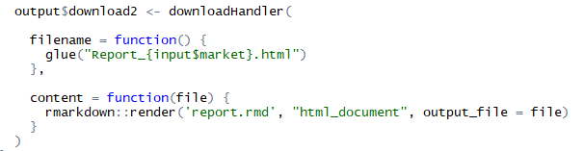
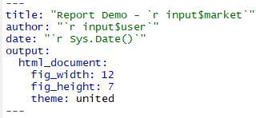
Rmarkdown Report Demo 1-11
Rendered rmarkdown can be downloaded using downloadHandler.
HTML recommended.
ui.r
server.r
xxxx.rmd
Input$xxx and any other reactive values within a shiny app are available in rmarkdown called within a shiny app.

Slide 57
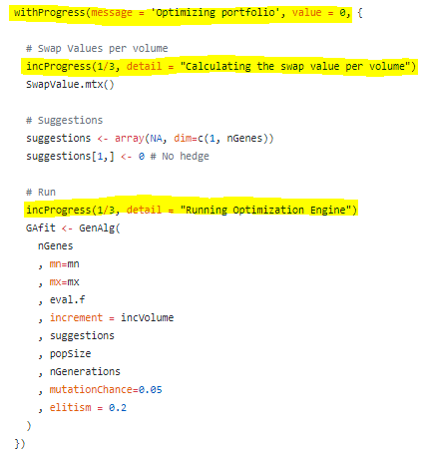

Progress bars
Progress messages for:
data imports
Calculations
Use within reactive environments.
The computation lives within the withProgress function.
Manually set progress increments.

Slide 58
Hiding Items Demo 1-12
Hide input widgets
Use Dynamic UI with conditions.
Note: active tab names can be returned as inputs.
Hide Tabs
Shinyjs (see the next slide)
Hide menu items
menuItemOutput / renderMenu
You may want to hide certain sections based on the user groups.

Slide 59
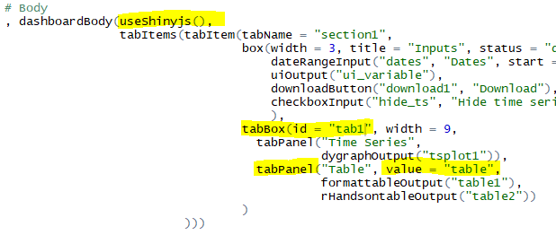
Shinyjs
Use it for:
Hide
Toggle
Disable
global.r
ui.r
server.r

Slide 60
Shiny vs Tableau

Slide 61
Shiny Pros vs Cons

